Slide 1






SKEWNESS AND KURTOSIS: UNDERSTANDING DATA SHAPE
AZEEZ AREGBESOLA
BEYOND THE NUMBERS

Slide 2




SKEWNESS AND KURTOSIS: UNDERSTANDING DATA SHAPE
WHEN ANALYZING DATA, CENTRAL TENDENCY AND DISPERSION TELL US A LOT, BUT SHAPE MATTERS TOO!
THIS POST WILL COVER:
Concept Introduction – What are skewness and kurtosis, and why do they matter?
Real-World Example – A fresh dataset showing different data distributions.
Simplified R Code – Step-by-step implementation.
Visualization – Histogram and density plots illustrating skewness and kurtosis.
Key Takeaways – Summary.
AZEEZ AREGBESOLA
BEYOND THE NUMBERS

Slide 3

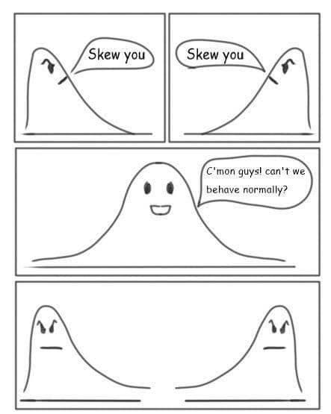


CONCEPT INTRODUCTION
SKEWNESS & KURTOSIS: INTERPRETING THE SHAPE OF DATA!
Why is this important?
Finance: Are stock returns skewed toward extreme gains/losses? 📈📉
Marketing: Do customer purchases follow a normal distribution? 🛍️
Healthcare: Are patient cholesterol levels heavily tailed? 🏥
Key metrics:
✅ Skewness – Measures if data is symmetrical or biased to one side.
✅ Kurtosis – Measures if data has extreme values (heavy or light tails).
AZEEZ AREGBESOLA
BEYOND THE NUMBERS

Slide 4




REAL-WORLD EXAMPLE
IMAGINE YOU'RE ANALYZING CUSTOMER SPENDING PER TRANSACTION AT A RETAIL STORE.
GOAL
SOLUTION
CHALLENGE
✅ Goal: Understand whether most customers spend around the same amount or if some customers spend significantly more than others.
✅ Challenge: Traditional measures (mean, median) don’t reveal distribution shape.
✅ Solution: Use skewness and kurtosis to analyze the data distribution.
AZEEZ AREGBESOLA
BEYOND THE NUMBERS

Slide 5

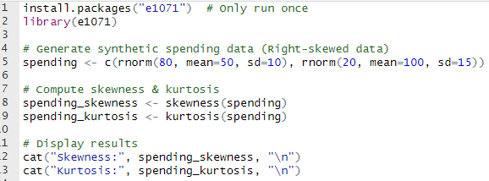
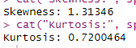
R IMPLEMENTATION
WE’LL GENERATE SYNTHETIC SPENDING DATA AND COMPUTE SKEWNESS & KURTOSIS.
AZEEZ AREGBESOLA
BEYOND THE NUMBERS

Slide 6
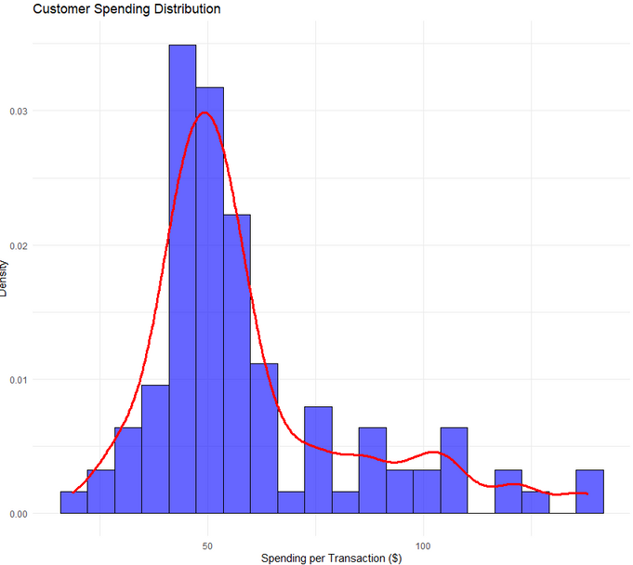
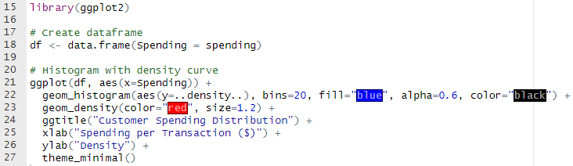
R IMPLEMENTATION
LET’S PLOT SPENDING DISTRIBUTION AND ANALYZE ITS SHAPE.
📌 A RIGHT-SKEWED DISTRIBUTION MEANS SOME CUSTOMERS SPEND MUCH MORE THAN THE AVERAGE.
📌 HIGHER KURTOSIS SUGGESTS EXTREME SPENDING OUTLIERS (BIG SPENDERS).
AZEEZ AREGBESOLA
BEYOND THE NUMBERS

Slide 7



KEY TAKEAWAYS
SUMMARY
✅ Skewness tells us if data leans left (-) or right (+).
✅ Kurtosis helps identify heavy tails (outliers) in a distribution.
✅ These metrics provide deeper insights beyond mean & standard deviation.
AZEEZ AREGBESOLA
BEYOND THE NUMBERS

Slide 8


FROM DATA TO DECISIONS
AZEEZ AREGBESOLA
BEYOND THE NUMBERS

